Slide 1
Principles of Database Systems (CS307) Lecture 11: Physical Storage System; Trigger
Ran Cheng
Department of Computer Science and Engineering
Southern University of Science and Technology
Most contents are from slides made by Stéphane Faroult, Dr. Yuxin Ma and the authors of Database System Concepts (7th Edition).
Their original slides have been modified to adapt to the schedule of CS307 at SUSTech.
Notes:
In this chapter, I will introduce how to retrieve data from one table. Just from one table. I will introduce how to retrieve data from multiple table in next chapter.

Slide 2
Physical Storage System

Slide 3
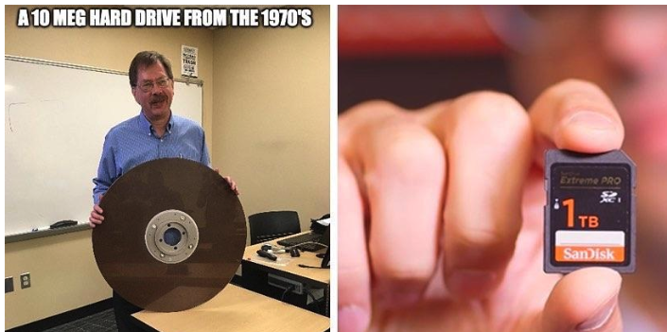
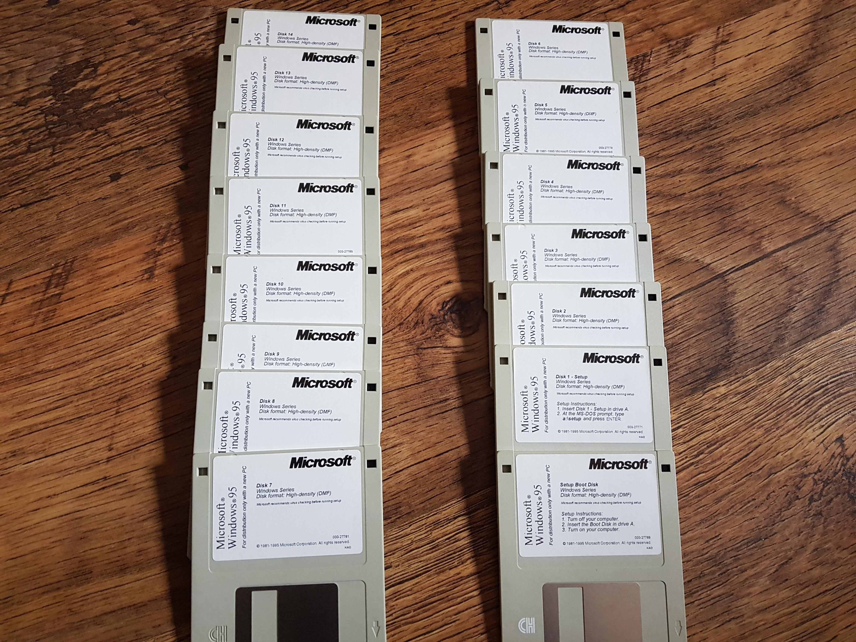
Physical Storage System
The hardware where data is recorded

Slide 4
Classification of Physical Storage Media
Can differentiate storage into:
Volatile (易失, 易挥发) storage: loses contents when power is switched off
Non-volatile storage:
Contents persist even when power is switched off.
Includes secondary and tertiary storage, as well as batter-backed up main-memory.
Factors affecting choice of storage media include
Speed with which data can be accessed
Cost per unit of data
Reliability

Slide 5
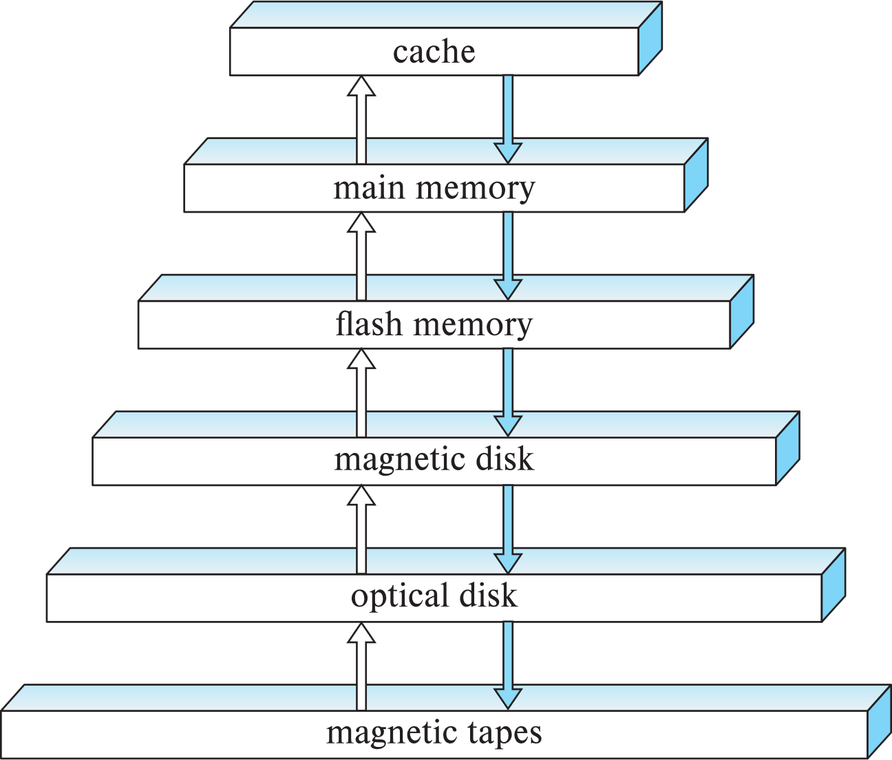
Storage Hierarchy
Primary storage
Fastest media but volatile (cache, main memory).
Secondary storage
Next level in hierarchy, non-volatile, moderately fast access time
… also called on-line storage
E.g., flash memory, magnetic disks
Tertiary storage
Lowest level in hierarchy, non-volatile, slow access time
… also called off-line storage and used for archival storage
e.g., magnetic tape, optical storage
Magnetic tape
Sequential access, 1 to 12 TB capacity
A few drives with many tapes
Juke boxes with petabytes (1000’s of TB) of storage

Slide 6
Storage Interfaces
Disk interface standards families
SATA (Serial Advanced Technology Attachment)
SATA 3 supports data transfer speeds of up to 6 gigabits/sec
SAS (Serial Attached SCSI)
SAS Version 3 supports 12 gigabits/sec
NVMe (Non-Volatile Memory Express) interface
Works with PCIe connectors to support lower latency and higher transfer rates
Supports data transfer rates of up to 24 gigabits/sec
Disks usually connected directly to computer system, however…
In Storage Area Networks (SAN), a large number of disks are connected by a high-speed network to a number of servers
In Network Attached Storage (NAS) networked storage provides a file system interface using networked file system protocol, instead of providing a disk system interface

Slide 7
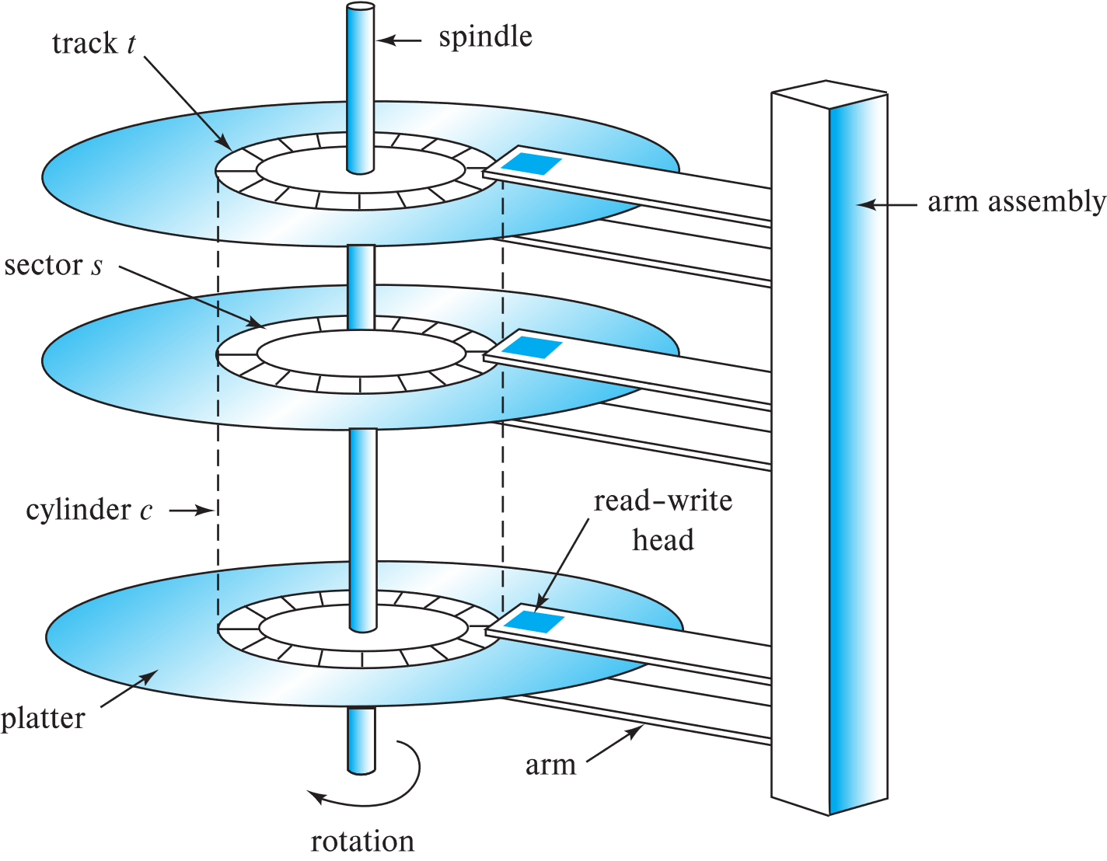
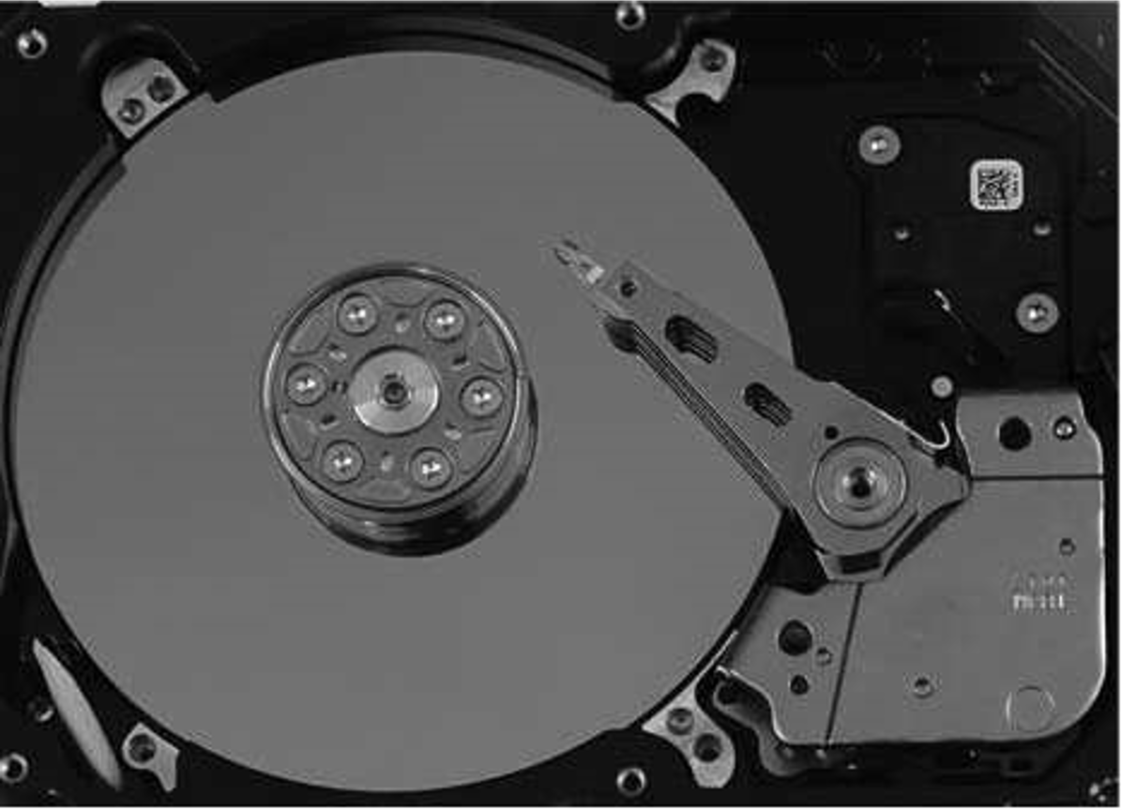
Magnetic Hard Disk Mechanism
Photo of a magnetic disk drive
Schematic diagram of magnetic disk drive

Slide 8
Magnetic Hard Disk Mechanism
Read-write head
Surface of platter divided into circular tracks
Over 50K-100K tracks per platter on typical hard disks
Each track is divided into sectors.
A sector is the smallest unit of data that can be read or written.
Sector size typically 512 bytes (modern OS requires 4KB)
Typical sectors per track: 500 to 1000 (on inner tracks) to 1000 to 2000 (on outer tracks)
To read/write a sector
Disk arm swings to position head on right track
Platter spins continually; data is read/written as sector passes under head
Head-disk assemblies
Multiple disk platters on a single spindle (1 to 5 usually)
One head per platter, mounted on a common arm.
Cylinder i consists of ith track of all the platters

Slide 9
Magnetic Hard Disk Mechanism
Disk controller （从指令到物理动作）
Interfaces between the computer system and the disk drive hardware.
令：Accepts high-level commands to read or write a sector
动：Initiates actions such as moving the disk arm to the right track and actually reading or writing the data
读：Computes and attaches checksums（校验和） to each sector to verify that data is read back correctly
If data is corrupted, with very high probability stored checksum won’t match recomputed checksum
写：Ensures successful writing by reading back sector after writing it
换：Performs remapping of bad sectors

Slide 10
Performance Measures of Disks
Access time: The time it takes from when a read or write request is issued to when data transfer begins. Consists of:
Seek time – time it takes to reposition the arm over the correct track.
Average seek time is 1/2 the worst case seek time.
Would be 1/3 if all tracks had the same number of sectors, and we ignore the time to start and stop arm movement
4 to 10 milliseconds on typical disks
Rotational latency – time it takes for the sector to be accessed to appear under the head.
4 to 11 milliseconds on typical disks (5400 to 15000 r.p.m.)
Average latency is 1/2 of the above latency.
Overall latency is 5 to 20 msec depending on disk model
Data-transfer rate: The rate at which data can be retrieved from or stored to the disk.
25 to 200 MB per second max rate, lower for inner tracks

Slide 11
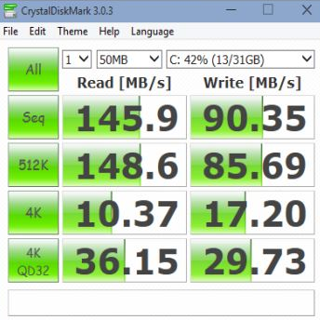
Performance Measures of Disks
Disk block is a logical unit for storage allocation and retrieval
4 to 16 kilobytes typically
Smaller blocks: more transfers from disk
Larger blocks: more space wasted due to partially filled blocks
Sequential access pattern
Successive requests are for successive disk blocks
Disk seek required only for first block
Random access pattern
Successive requests are for blocks that can be anywhere on disk
Each access requires a seek
Transfer rates are low since a lot of time is wasted in seeks
I/O operations per second (IOPS)
Number of random block reads that a disk can support per second
50 to 200 IOPS on current generation magnetic disks

Slide 12
Performance Measures of Disks
Mean time to failure (MTTF) – the average time the disk is expected to run continuously without any failure.
Typically, 3 to 5 years
Probability of failure of new disks is quite low, corresponding to a “theoretical MTTF” of 500,000 to 1,200,000 hours for a new disk
E.g., an MTTF of 1,200,000 hours for a new disk means that given 1000 relatively new disks, on an average one will fail every 1200 hours
MTTF decreases as disk ages

Slide 13
Flash Storage
NOR flash vs NAND flash
NAND flash
Used widely for storage, cheaper than NOR flash
Requires page-at-a-time read (page: 512 bytes to 4 KB)
20 to 100 microseconds for a page read
Not much difference between sequential and random read
Page can only be written once
Must be erased to allow rewrite
Solid state disks (SSD)
Use standard block-oriented disk interfaces, but store data on multiple flash storage devices internally
Transfer rate of up to 500 MB/sec using SATA, and up to 3 GB/sec using NVMe PCIe

Slide 14
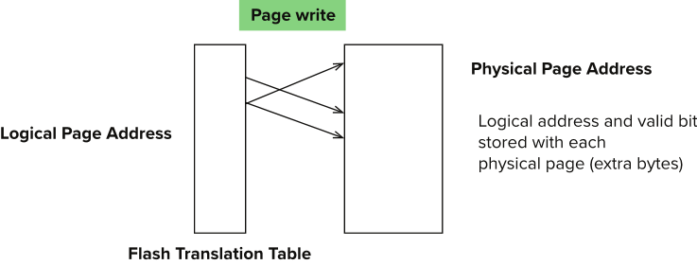
Flash Storage
Erase happens in units of erase block
Takes 2 to 5 millisecs
Erase block typically 256 KB to 1 MB (128 to 256 pages)
Remapping of logical page addresses to physical page addresses avoids waiting for erase
Flash translation table tracks mapping
Also stored in a label field of flash page
Remapping carried out by flash translation layer
After 100,000 to 1,000,000 erases, erase block becomes unreliable and cannot be used
Wear leveling

Slide 15
SSD Performance Metrics
Random reads/writes per second
Typical 4 KB reads: 10,000 reads per second (10,000 IOPS)
Typical 4KB writes: 40,000 IOPS
SSDs support parallel reads
Typical 4KB reads:
100,000 IOPS with 32 requests in parallel (QD-32) on SATA
350,000 IOPS with QD-32 on NVMe PCIe
Typical 4KB writes:
100,000 IOPS with QD-32, even higher on some models
Data transfer rate for sequential reads/writes
400 MB/sec for SATA3, 2 to 3 GB/sec using NVMe PCIe
Hybrid disks: Combine small amount of flash cache with larger magnetic disk

Slide 16
Storage Class Memory: Magnetic Tapes
Hold large volumes of data and provide high transfer rates
Few GB for DAT (Digital Audio Tape) format, 10-40 GB with DLT (Digital Linear Tape) format, 100 GB+ with Ultrium format, and 330 GB with Ampex helical scan format
Transfer rates from few to 10s of MB/s
Tapes are cheap, but cost of drives is very high
Very slow access time in comparison to magnetic and optical disks
limited to sequential access.
Some formats (Accelis) provide faster seek (10s of seconds) at cost of lower capacity
Used mainly for backup, for storage of infrequently used information, and as an off-line medium for transferring information from one system to another.
Tape jukeboxes used for very large capacity storage
Multiple petabytes (10^15 bytes)

Slide 17
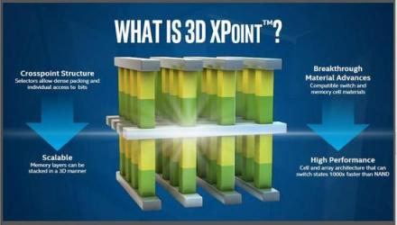
Storage Class Memory: 3D-XPoint
3D-XPoint memory technology pioneered by Intel
Available as Intel Optane
SSD interface shipped from 2017
Allows lower latency than flash SSDs
Non-volatile memory interface announced in 2018
Supports direct access to words, at speeds comparable to main-memory speeds

Slide 18
RAID
RAID: Redundant Arrays of Independent Disks
Disk organization techniques that manage a large numbers of disks, providing a view of a single disk of
high capacity and high speed by using multiple disks in parallel,
high reliability by storing data redundantly, so that data can be recovered even if a disk fails
The chance that some disk out of a set of N disks will fail is much higher than the chance that a specific single disk will fail.
e.g., a system with 100 disks, each with MTTF (Mean Time To Failure) of 100,000 hours (approx. 11 years), will have a system MTTF of 1000 hours (approx. 41 days)
Techniques for using redundancy to avoid data loss are critical with large numbers of disks

Slide 19
Improvement of Reliability via Redundancy
Redundancy – store extra information that can be used to rebuild information lost in a disk failure
E.g., Mirroring (or shadowing)
Duplicate every disk. Logical disk consists of two physical disks.
Every write is carried out on both disks
Reads can take place from either disk
If one disk in a pair fails, data still available in the other
Data loss would occur only if a disk fails, and its mirror disk also fails before the system is repaired
Probability of combined event is very small
Except for dependent failure modes such as fire or building collapse or electrical power surges
Mean time to data loss depends on mean time to failure, and mean time to repair
E.g., MTTF of 100,000 hours, mean time to repair of 10 hours gives mean time to data loss of 500*106 hours (or 57,000 years) for a mirrored pair of disks (ignoring dependent failure modes)

Slide 20
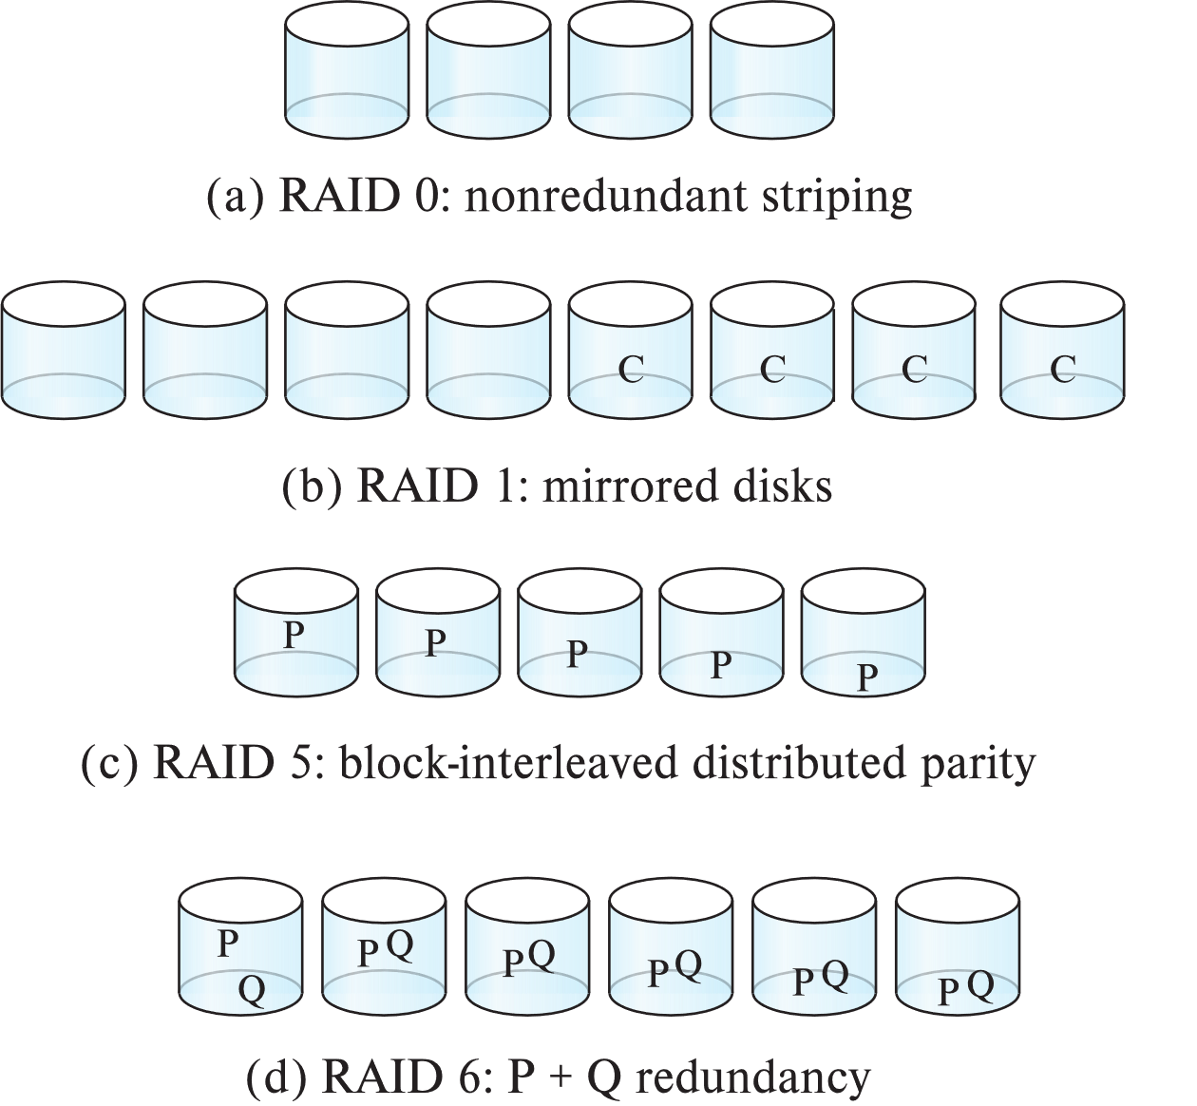

RAID Levels
Schemes to provide redundancy at lower cost by using disk striping combined with parity bits
Different RAID organizations, or RAID levels, have differing cost, performance and reliability characteristics
RAID 0: Block striping (分段); non-redundant
RAID 1: Mirrored disks with block striping
RAID 10: Combination of striping and mirroring
RAID 5: Block-interleaved distributed parity
RAID 6: P+Q Redundancy scheme

Slide 21
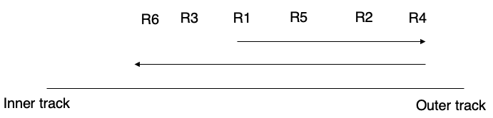
Optimization of Disk-Block Access
Buffering
In-memory buffer to cache disk blocks
Read-ahead
Read extra blocks from a track in anticipation that they will be requested soon
Disk-arm-scheduling algorithms
Re-order block requests so that disk arm movement is minimized
E.g., elevator algorithm

Slide 22
Optimization of Disk-Block Access
File organization
Allocate blocks of a file in as contiguous a manner as possible
Allocation in units of extents
Files may get fragmented
E.g., if free blocks on disk are scattered, and newly created file has its blocks scattered over the disk
Sequential access to a fragmented file results in increased disk arm movement
Some systems have utilities to defragment the file system, in order to speed up file access
Non-volatile write buffers
Temporarily store the written data
… and immediately notifies the OS that writing is completed without errors
Write data into the disk when idle
… with some optimizations

Slide 23
Trigger

Slide 24
Trigger - Actions When Changing Tables
We can attach “actions” to a table
They will be executed automatically whenever the data in the table changes
Purpose of using triggers
Validate data
Checking complex rules
Manage data redundancy
A trigger is a specification that the database should automatically execute a particular function whenever a certain type of operation is performed.
-- Chapter 39, PostgreSQL Documentation
A trigger is a statement that the system executes automatically as a side effect of a modification to the database.
-- Chapter 5.3, Database System Concepts, 7th

Slide 25


Purpose of Using Triggers
Validate data
Some data are badly processed in programs before sending to the database
We need to validate such data before inserting them into the database
“On-the-fly” modification
Change the input directly when the input arrives
永远的神
永远滴神
永远の神
yyds
YYDS
yy的s
“yyds”

Slide 26
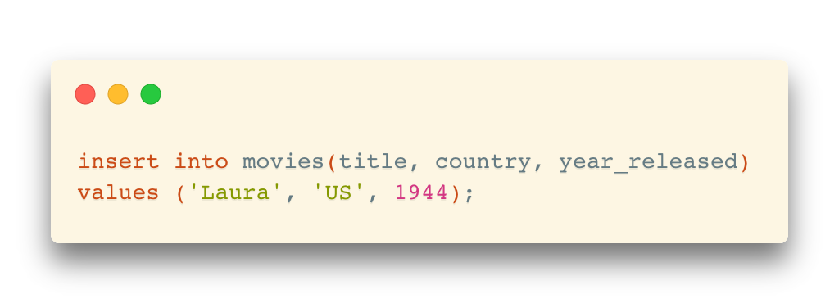
Purpose of Using Triggers
Validate data
Example: insert a row in the movies table
In the JDBC program, an insert request is written like the following:
Although,
Such validation or transformation should be better handled by the application programs
Need to update it to ’us’ before inserting

Slide 27
Purpose of Using Triggers
Check complex rules
Sometimes, the business rules are so complex that it cannot be checked via declarative constraints

Slide 28
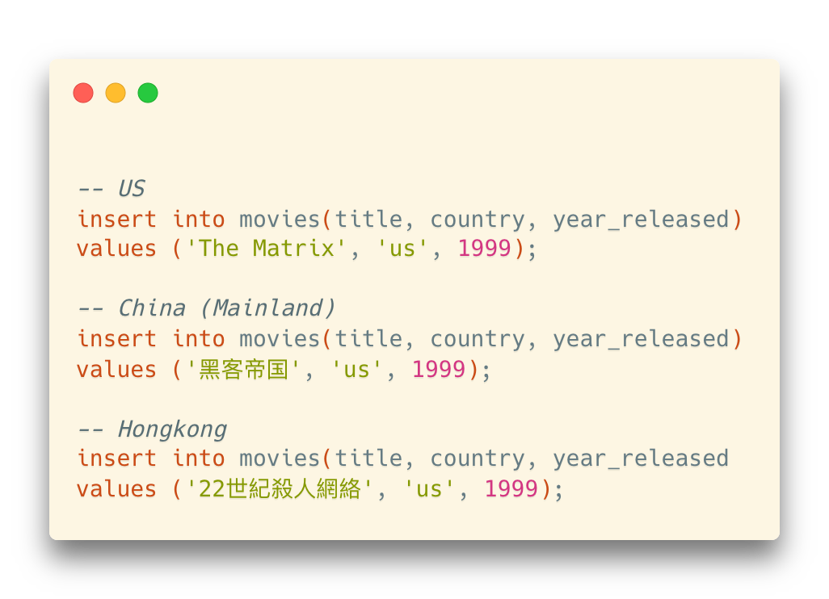
Purpose of Using Triggers
Manage data redundancy
Some redundancy issues may not be avoided by simply adding constraints
For example: We inserted the same movie but in different languages
It satisfies the constraint of uniqueness on (title, country, year_released)
… but they represent the same movie

Slide 29
Trigger Activation
Two key points:
When to fire a trigger?
What (command) fires a trigger?

Slide 30
Trigger Activation
When to fire a trigger?
In general: “During the change of data”
… but we need a detailed discussion
--- Note: “During the change” means select queries won’t fire a trigger.

Slide 31
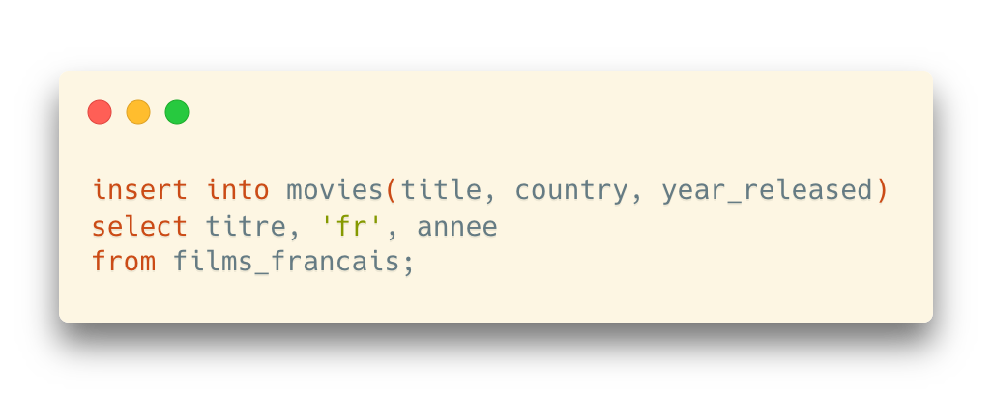
Trigger Activation: When
Example: Insert a set of rows with “insert into select”
One statement, multiple rows

Slide 32
Trigger Activation: When
Example: Insert a set of rows with “insert into select”
One statement, multiple rows
Option 1: Fire a trigger only once for the statement
Before the first row is inserted, or after the last row is inserted
Option 2: Fire a trigger for each row
Before or after the row is inserted

Slide 33






Trigger Activation: When
Different options between DBMS products
Before statement
Before each row
After each row
After statement
Before statement
Before each row
After each row
After statement
Before statement
Before each row
After each row
After statement

Slide 34
Trigger Activation: What
What (command) fires a trigger?
insert
update
delete

Slide 35
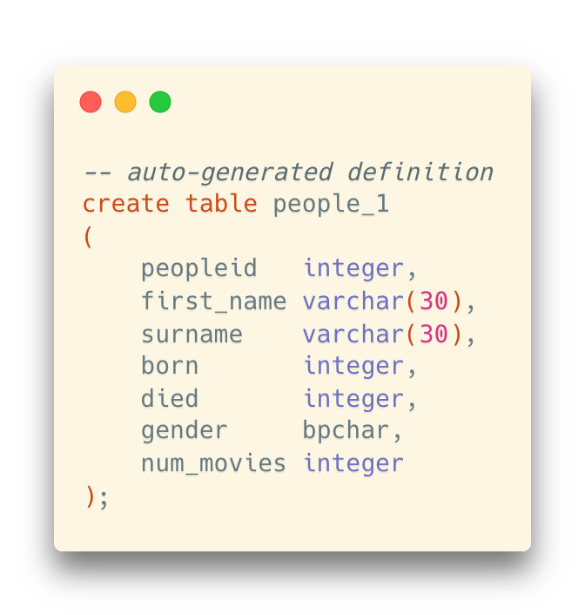
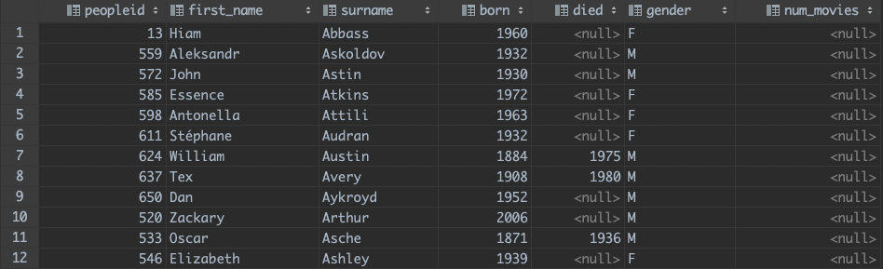
Example of Triggers
A (Toy) Example
For the following people_1 table, count the number of movies when updating a person and save the result in the num_movies column

Slide 36
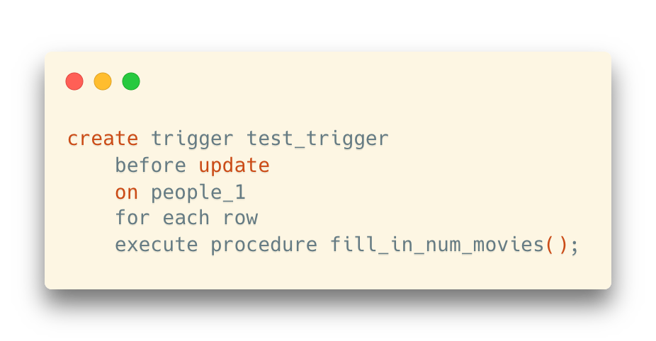
Example of Triggers
Create a trigger

Slide 37
Example of Triggers
Create a trigger
Name of the trigger

Slide 38
Example of Triggers
{ BEFORE | AFTER | INSTEAD OF } { event [ OR ... ] }
Specify when the trigger will be executed
before | after
… and on what operations the trigger will be executed
insert [or update [or delete]]
Create a trigger

Slide 39
Example of Triggers
Create a trigger
The table name
“for each row”
or
“for each statement” (default)

Slide 40
Example of Triggers
Create a trigger
The actual procedure for the trigger

Slide 41
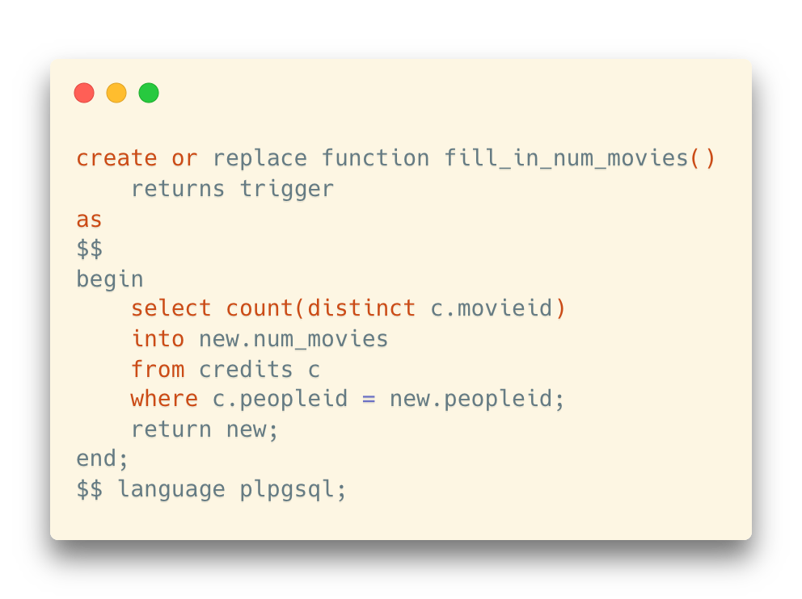
Example of Triggers
Create a trigger
Besides, a corresponding procedure should be created as well

Slide 42
Example of Triggers
Create a trigger
Besides, a corresponding procedure should be created as well
“trigger” is the return type

Slide 43
Example of Triggers
Create a trigger
Besides, a corresponding procedure should be created as well
”new” and “old” are two internal variables that represents the row before and after the changes

Slide 44
Example of Triggers
Create a trigger
Besides, a corresponding procedure should be created as well
Remember to return the result which will be used in the update statement

Slide 45
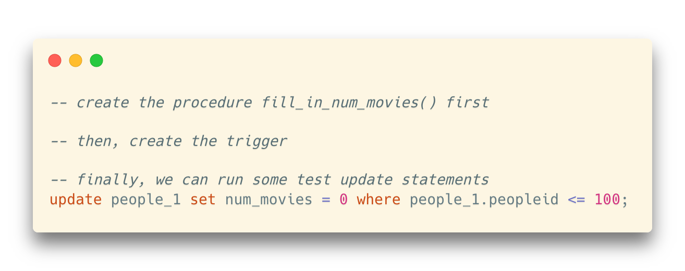
Example of Triggers
Create a trigger
Besides, a corresponding procedure should be created as well
Remember to create the procedure before creating the trigger
Run test updates

Slide 46
Before and After Triggers
Differences between before and after triggers
“Before” and “after” the operation is done (insert, update, delete)
If we want to update the incoming values in an update statement, the “before trigger” should be used since the incoming values have not been written to the table yet

Slide 47
Before and After Triggers
Typical usage scenarios for trigger settings
Modify input on the fly
before insert / update
for each row
Check complex rules
before insert / update / delete
for each row
Manage data redundancy
after insert / update / delete
for each row

Slide 48
Example: Auditing
One good example of managing some data redundancy is keeping an audit trail
It won't do anything for people who steal data
(remember that select cannot fire a trigger – although with the big products you can trace all queries)
… but it may be useful for checking people who modify data that they aren't supposed to modify

Slide 49
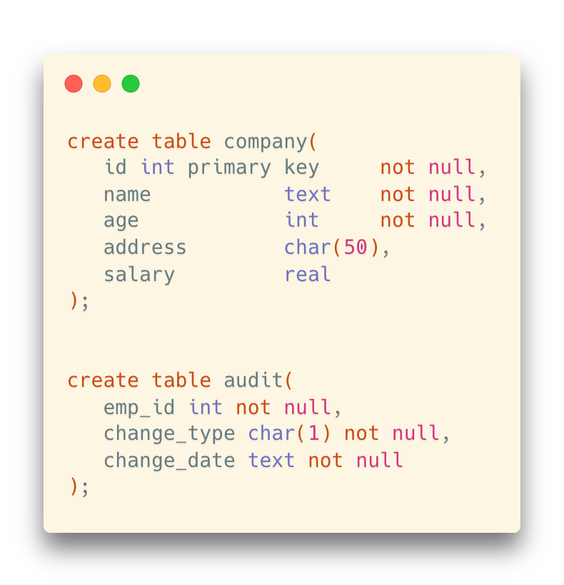
Example: Auditing
Trace the insertions and updates to employees in a company

Slide 50
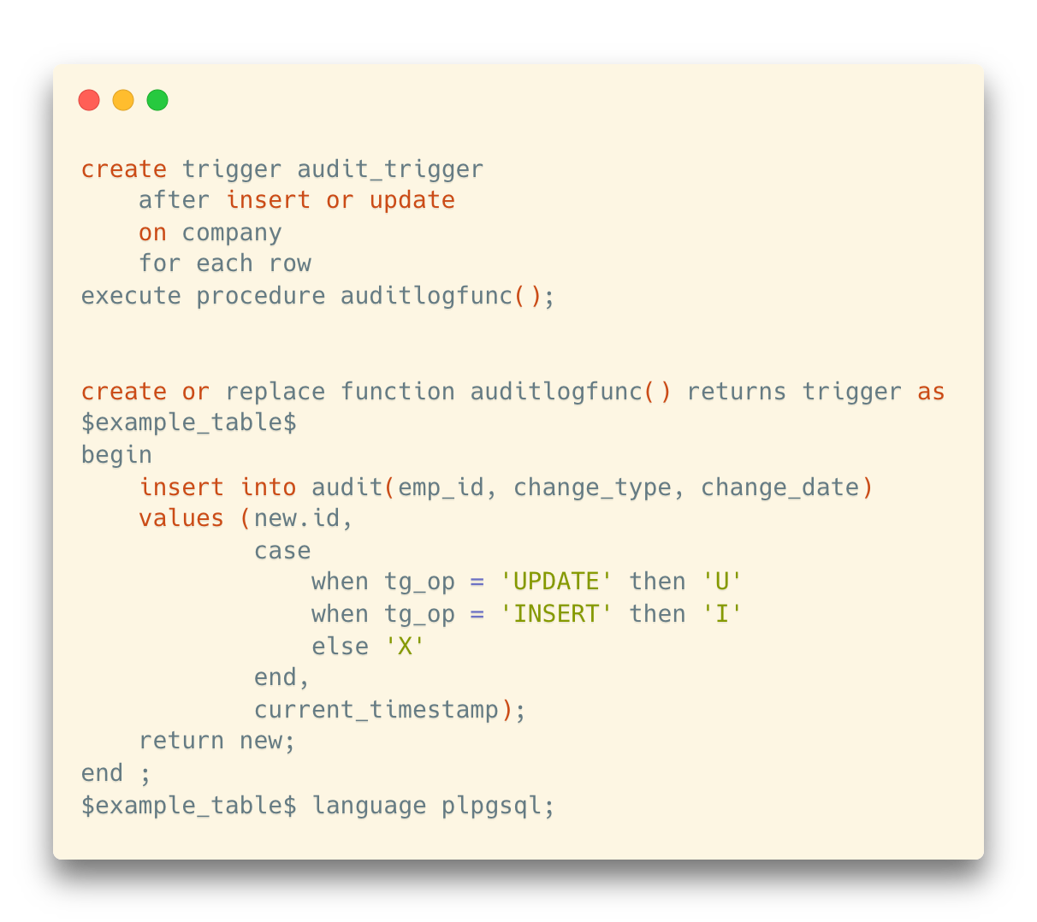
Example: Auditing
Trace the insertions and updates to employees in a company

Slide 51
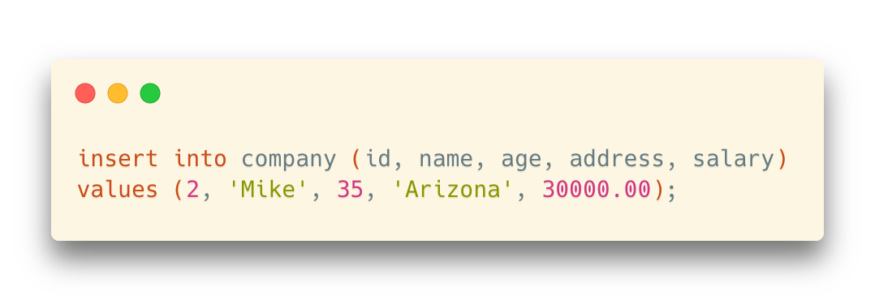
Example: Auditing
Trace the insertions and updates to employees in a company
company
audit

